Slide 1
GREENHOUSE MONITORING AND CONTOLLING
BY IBM WATSON
ABSTRACT:
In the 21st century , one of the most significant technologies is the Internet of Things (IoT) which has rapidly developed covering hundreds of applications in the civil, health, military and agriculture areas. In modern greenhooperationuses, several measurement points are required to trace down the local climate parameters in different in a large scale greenhouse in order to ensure proper of the greenhouse automation system. This can be done using prototype consisting of DHT11 , mq-135 and mq-2 which are used to measure greenhouses’ temperature, air quality , detection of harmful gases and humidity. Measurement data have been shared with the help of IoT. With this system farmers can control their greenhouse from their mobile phones or computers which have internet connection.

Slide 2
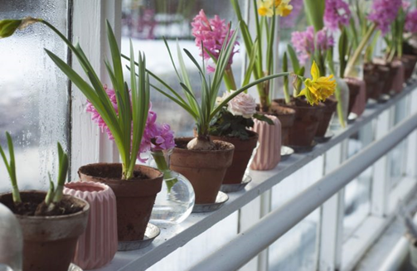
Introduction:
In recent scenario of climate change and its effect on the environment has motivated the farmers to install greenhouses in their fields. But maintaining a greenhouse and its plantation is very labour intensive and majority of them perform vital operations intuitively. Also agricultural researchers are facing shortage of good quality of data which is crucial for crop development. Thus we have developed such a cost effective system using Internet of Things (IoT) technology which is focused on solving these particular problems, our system automates the greenhouse maintenance operations and monitor the growth conditions inside the green house closely.
Very often farmer or Agriculturists rely upon their gut to figure out the vital operations which can have an adverse effect on their production, here sensor data in the fields or in the greenhouse can help farmers plan an optimum time to carry out the harvesting would then ensure that the crop is ready and the value generated is maximized. Thus agriculture is one of the largest use cases of IoT, besides this selective Irrigation, livestock monitoring, remote equipment operation and monitoring, predictive analytics for crops and livestock, etc. with conditions inside the greenhouse closely.

Slide 3
BLOCK DIAGRAM:
DHT-11 Sensor
N
O
D
E
M
C
U
IBM Cloud
Mobile App
MQ-135
(Air Quality)
Watson IOT
Node-Red
MQ-2
(Gas Sensor)

Slide 4

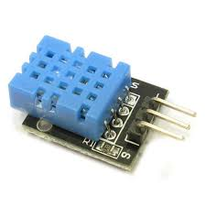
HARDWARE COMPONENTS:
1:DHT-11 Sensor
DHT -11 sensor is a Temperature-Humidity Sensor .
This module can be applied to environmental temperature & humility measurement.
Operating voltage 3.3V-5.5V
Pin No. Symbol Descriptions
1 DOUT Communication port
2 GND Power ground
3 VCC Positive power supply (3.3V-5.5V)

Slide 5
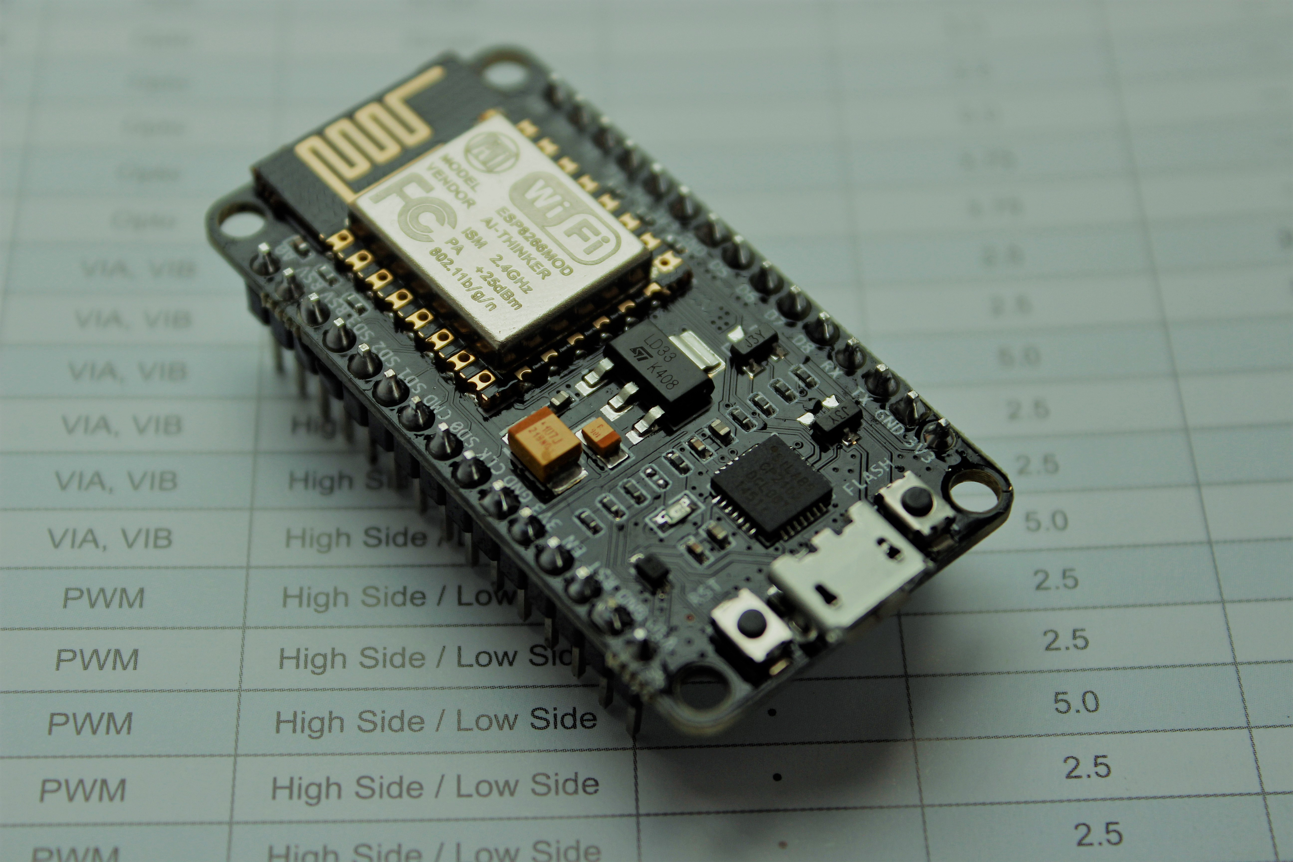
2:Nodemcu ESP8266
I/O index ESP8266 pin
0 [*] GPIO16
1 GPIO5
2 GPIO4
3 GPIO0
4 GPIO2
5 GPIO14
6 GPIO12
7 GPIO13
8 GPIO15
9 GPIO3
10 GPIO1
11 GPIO9
12 GPIO10
NodeMCU is an open source Lua based firmware for the ESP8266 Wi-Fi SOC from Espressif and uses an on-module flash-based SPIFFS file system. NodeMCU is implemented in C and is layered on the Espressif NON-OS SDK.
The firmware was initially developed as is a companion project to the popular ESP8266-based NodeMCU development modules, but the project is now community-supported, and the firmware can now be run on any ESP module

Slide 6
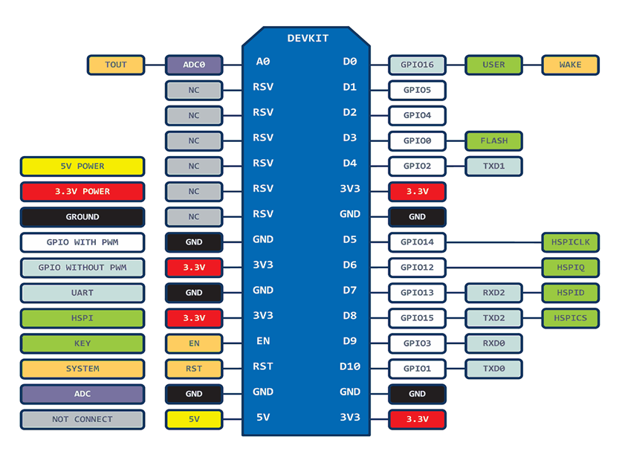
NODEMCU

Slide 7
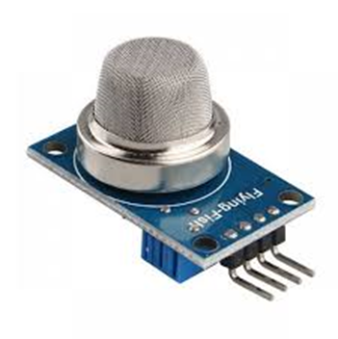

3:MQ-135
Air quality sensor for detecting a wide range of gases, including NH3, NOx, alcohol, benzene, smoke and CO2. Ideal for use in office or factory. MQ135 gas sensor has high sensitivity to Ammonia, Sulfide and Benze steam, also sensitive to smoke and other harmful gases. It is with low cost and particularly suitable for Air quality monitoring application.
Features:
High Sensitivity.
High sensitivity to Ammonia, Sulfide and Benzene.
Stable and Long Life.
Detection Range: 10 - 300 ppm NH3, 10 - 1000 ppm Benzene, 10 - 300 Alcohol.
Heater Voltage: 5.0V.
Dimensions: 18mm Diameter, 17mm High excluding pins, Pins - 6mm High
Long life and low cost

Slide 8
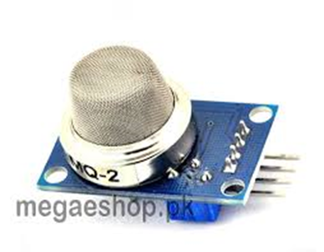
4:MQ-2
The Grove - Gas Sensor(MQ2) module is useful for gas leakage detection (home and industry). It is suitable for detecting H2, LPG, CH4, CO, Alcohol, Smoke or Propane. Due to its high sensitivity and fast response time, measurement can be taken as soon as possible. The sensitivity of the sensor can be adjusted by potentiometer.
Features:
• Wide detecting scope
• Stable and long lifetime
• Fast response and High sensitivity
Application Ideas:
• Gas leakage detection.
• Toys.

Slide 9
Software Components:
1:Aurdino IDE
Arduino is an open-source hardware and software company, project and user community that designs and manufactures single-board microcontrollers and microcontroller kits for building digital devices and interactive objects that can sense and control both physically and digitally. Its products are licensed under the GNU Lesser General Public License (LGPL) or the GNU General Public License(GPL),^{[1]} permitting the manufacture of Arduino boards and software distribution by anyone. Arduino boards are available commercially in preassembled form or as do-it-yourself (DIY) kits.
2:IBM Watson cloud platform
Watson on the IBM Cloud allows you to integrate the world's most powerful AI into your application and store, train and manage your data in the most secure cloud.

Slide 10
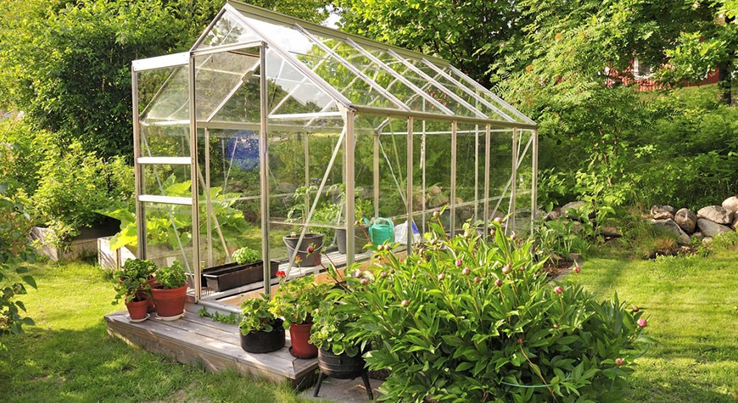
Advantages of greenhouse monitoring are :
• Increase in fertility.
• Better productivity.
• Dependence on other people is reduced.
• Percentage of germination of seeds is high
in green house.

Slide 11
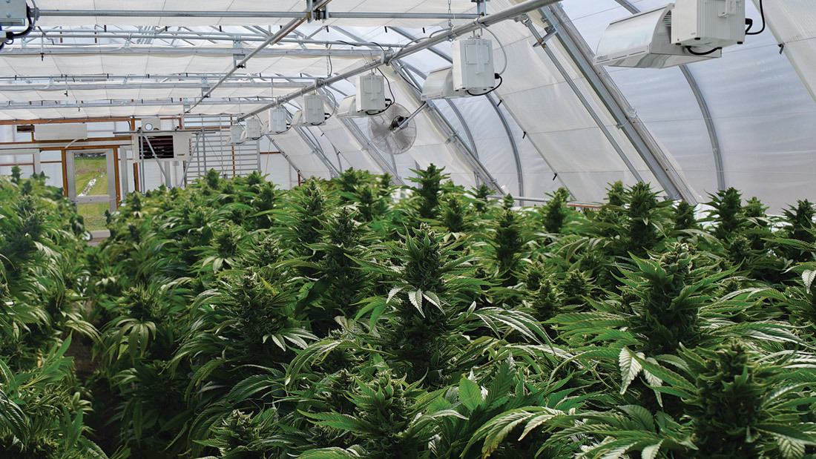
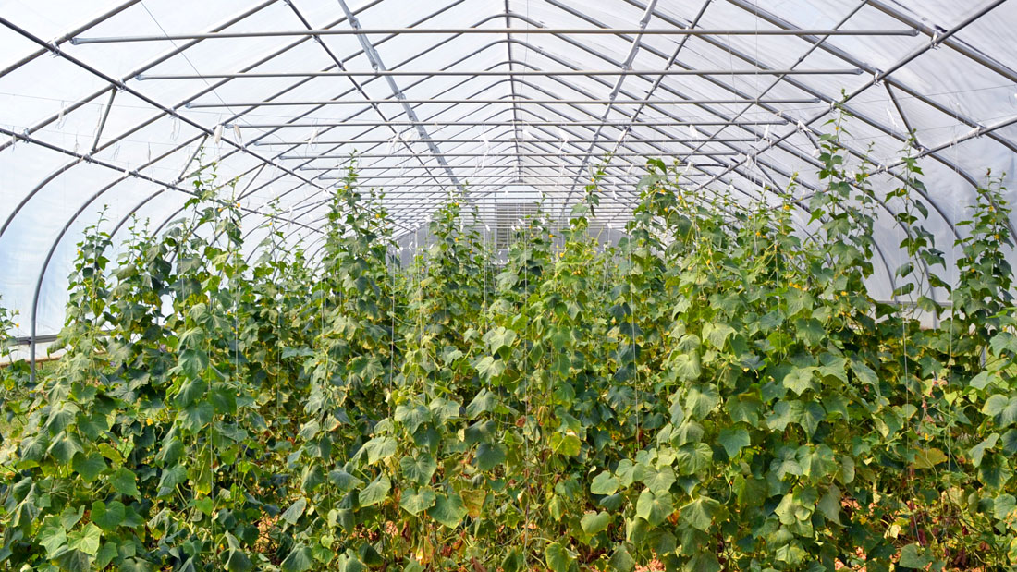
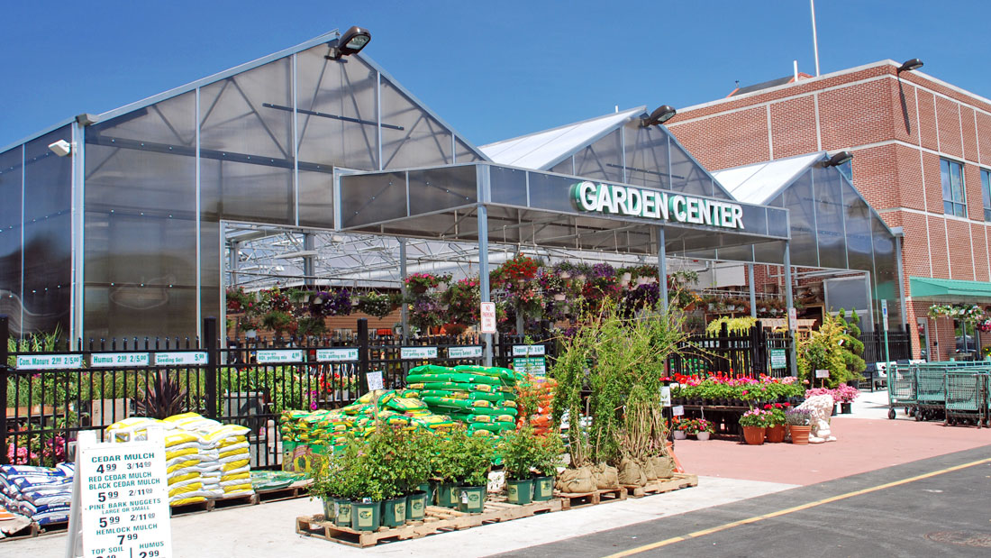
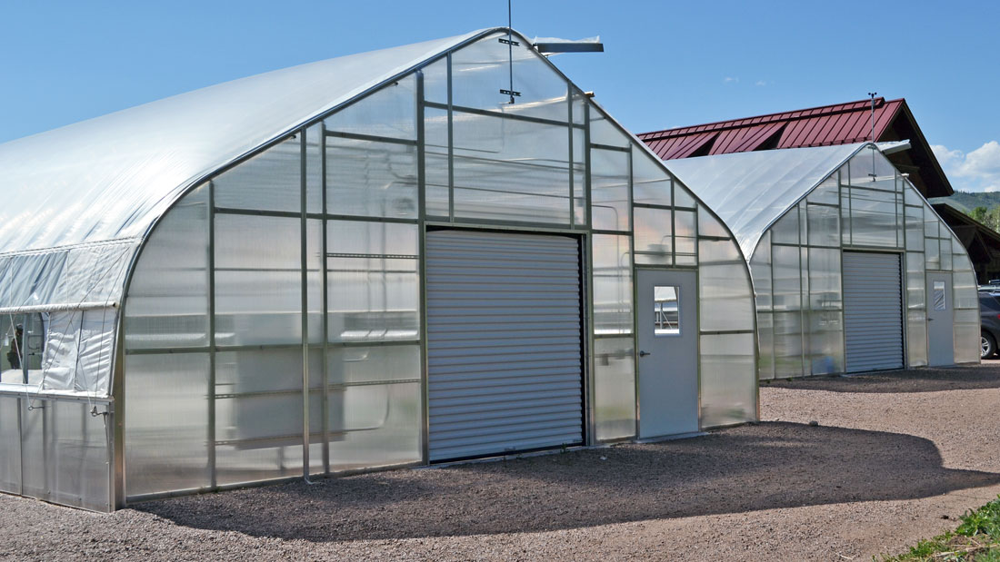
APPLICATIONS OF GREENHOUSE MONITORING :
1. CANNABIS PRODUCTION
2. GROWING VEGETABLES
3. RETAIL MARKET
4. COMMERCIAL GROWING

Slide 12
CONCLUSION:
Our system enables people to monitor and manage growing conditions of their greenhouse. The use sensor nodes, internet connection, and the cloud will deliver real-time updates about plants and help people grow plants more efficiently, with all observation and conventional tests results conclude that our project will provide a solution for automating greenhouse activities and irrigation activities. Implementation of such a system in the field can definitely help to improve the yield of the crops and overall production, and with its quality to cost ratio, it will be affordable to the majority of the agricultural community and also to agro-based industries.

Slide 13
THANK YOU

Slide 14
DONE BY
- INNOVATORS
D. Madhuri
G.Kavya
P. Venkat sai

